Slide 1


FRC 1159 Software team tasks

Slide 2
Tasks
Lear LabVIEW
Lear how to program the Robot
Program the Radio
Imaging the RoboRIO
Make a build
Deploy a build
Lear how to program the motor controllers
Learn how to use Github

Slide 3
Learn Labview

Slide 4
Install Labview and tools
Install LabVIEW for FRC
Install the FRC Game Tools

Slide 5
Install Labview and tools
Installation Instructions for Teams Using LabVIEW for Development
This option allows you to program your robot in LabVIEW, perform vision analysis, and capture from USB cameras.
Launch the installer. This will initiate a pre-install of NI Package Manager. After the NI package manager installation completes, you will be presented with a list of software to install.
On the "Select Products" dialog, accept the default selections. This includes:
LabVIEW (32-bit) English - 2020 SP1
LabVIEW Real-Time Module English - 2020
Vision Development Module - 2021

Slide 6
Install Labview and tools
LabVIEW Robotics Module for FRC - 2020
NI CompactRIO - 21.0.0
NI-IMAQdx driver - 21.0.0
On the "Additional items you may wish to install" dialog, accept the default selections. NOTE: If you do not accept the default selections, it is likely that some components required for programming your robot will not be installed.
Accept the licensing agreements and proceed through the installation wizard.
This option has the following system requirements:
Operating System: Windows 10/8.1
Free Space Before Install: 42.1GB Free Space After Vision Install: 35.1GB Free Space after full install: 19.6 Disk Footprint: 15.2 GB

Slide 7
Install Labview and tools
To Activate LabVIEW
Login to National Instruments
Username: ramonarampage@gmail.com
Password: ramona1159
Enter the serial number to activate:
B05P07428

Slide 8
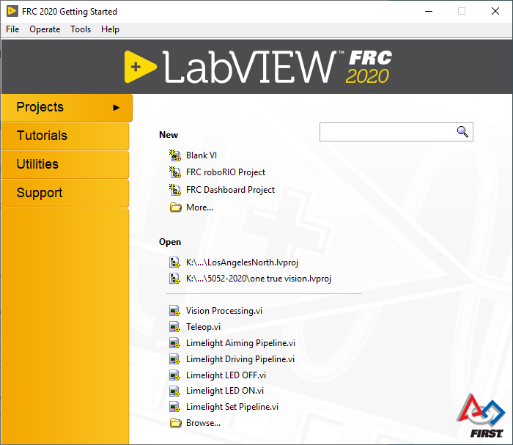
Install Labview and tools
Once LabVIEW and the FRC Game Tools are installed, when LabVIEW starts up it should look like this →

Slide 9
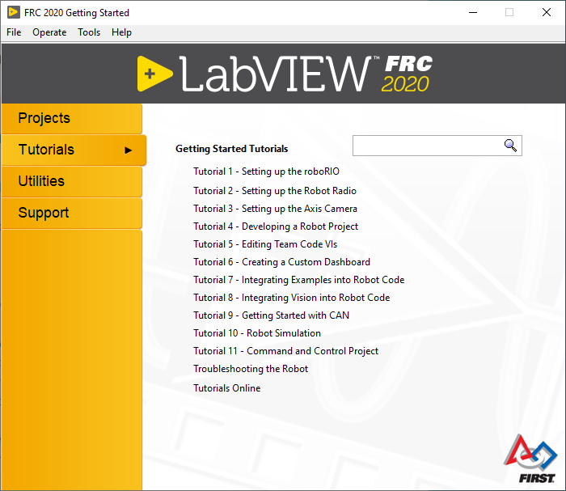
LABVIEW tutorials
You can access all the tutorials listed here from the Tutorials tab.
The tutorials are quick and to the point.

Slide 10
LABVIEW tutorials
Learn NI LabVIEW Basics
Getting Started with LabVIEW
FRC LabVIEW Tutorial
Fundamentals of LabVIEW for FRC - Episode 1
Fundamentals of LabVIEW for FRC: Episode 2 - Vision and Control
Fundamentals of LabVIEW for FRC: Episode 3 - Command and Control Architecture
Fundamentals of LabVIEW for FRC: Episode 4 - Source Code Control and Tips & Tricks

Slide 11
Useful links
Most of the links on this presentation come from the link below
Control System and Programming Documentation

Slide 12
Learn to Program the robot

Slide 13
Hardware & software overview
Hardware Component Overview
Software Component Overview

Slide 14
Frc labview programming
Installing LabVIEW for FRC (LabVIEW only)
Installing the FRC Game Tools
Re-licensing LabVIEW for 2021 Season
Creating Robot Programs
Creating, Building and Loading your Benchtop Test Program
Tank Drive Tutorial
Command and Control Tutorial
LabVIEW Resources
LabVIEW Resources
Waiting for Target to Respond - Recovering from bad loops

Slide 15
Frc labview programming
Talon SRX CAN
How To Toggle Between Two Camera Modes
LabVIEW Examples and Tutorials
Add an Independent Motor to a Project
Keyboard Navigation with the roboRIO
Making a One-Shot Button Press
Adding Safety Features to Your Robot Code
How to Use Joystick Buttons to Control Motors or Solenoids
Local and Global Variables in LabVIEW for FRC
Using the Compressor in LabVIEW

Slide 16
FRC WPI Robotics Library Overview
FRC WPI Robotics Library Overview
The link above takes to the topics below
Introduction
RobotDrive
Sensors
Actuators
I/O
Driver Station
Camera
Communication
Utilities
Power

Slide 17
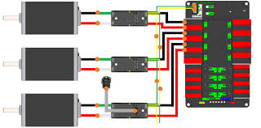
Programming motor control

Slide 18
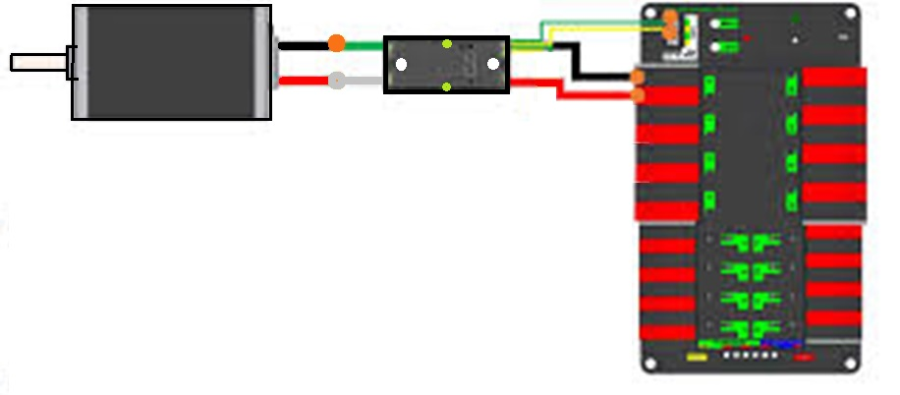
Programming motor control
Motor
Motor Controller
PDP – Power Distribution Panel

Slide 19
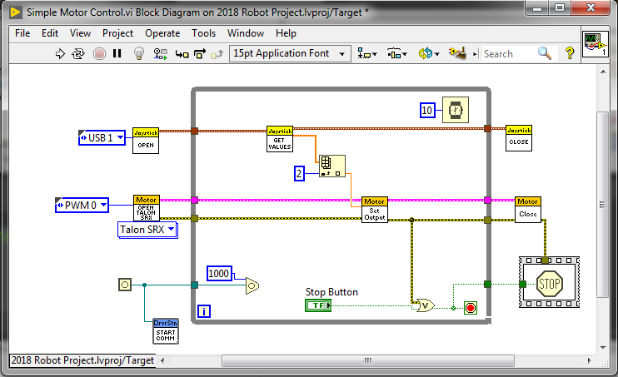
Programming motor control
Basic Motor Control Tutorial
Click on the link above to learn how to make the motor control program below

Slide 20
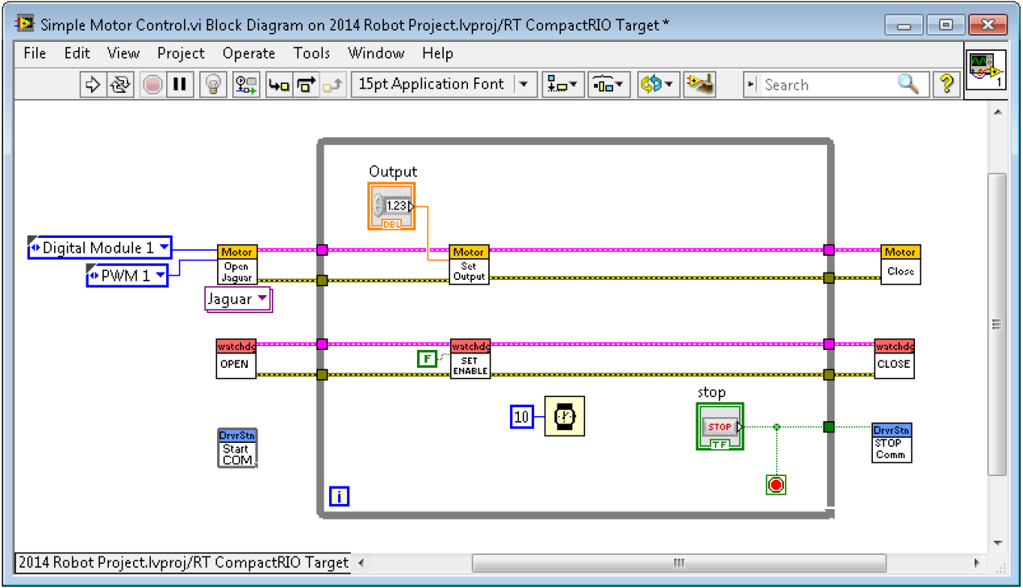
Programming motor control

Slide 21
Drive motors
Initialize
Control
Close

Slide 22
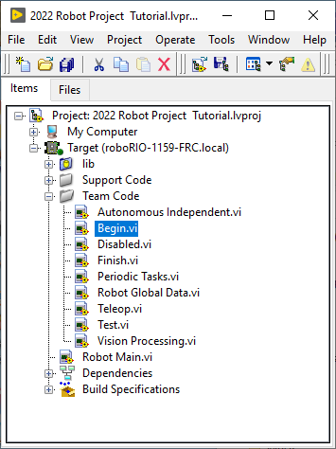
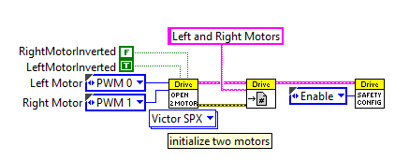
Drive motors – Initialize motors
The following code goes in Begin.vi

Slide 23
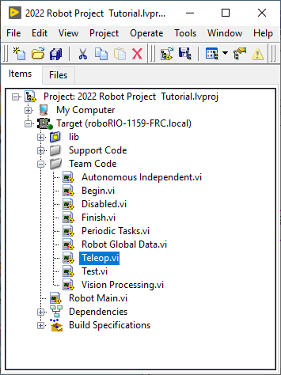
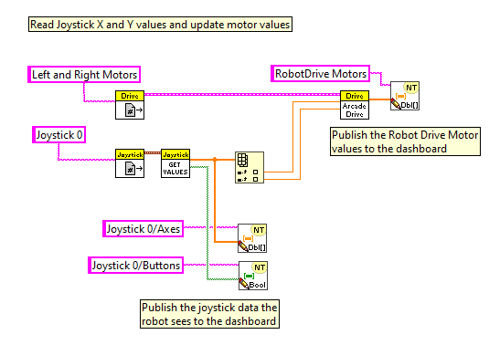
Drive motors – control Motors
The following code goes in Teleop.vi

Slide 24
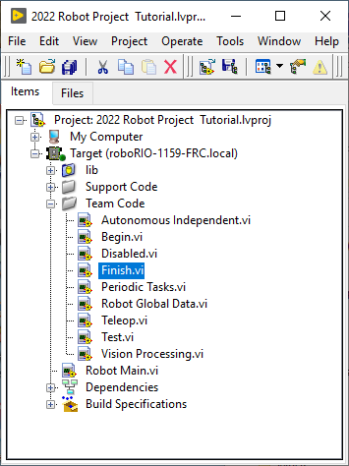
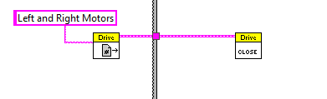
Drive motors – close motors
The following code goes in Finish.vi

Slide 25
Other motors
Add an Independent Motor to a Project
Initialize
Use
Close

Slide 26
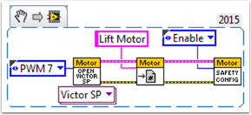
Other motors - initialize
FIRST, create a motor reference in the Begin.vi, using the Motor Control Open VI and Motor Control Refnum Registry Set VI. These can be found by right-clicking in the block diagram and going to WPI Robotics Library>>RobotDrive>>Motor Control. Choose your PWM line and name your motor. I named mine “Lift Motor” and connected it to PWM 7. (I also included and enabled the Motor Control Safety Config VI, which automatically turns off the motor if it loses connection.)

Slide 27
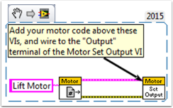
Other motors – Use it
Now, reference your motor (the name has to be exact) in the Teleop.vi using the Motor Control Refnum Registry Get VI and tell it what to do with the Motor Control Set Output VI. These are in the same place as the above VIs.

Slide 28
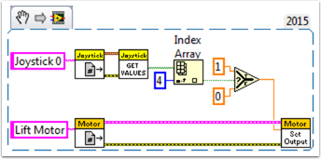
Other motors – example
For example, the next snippet tells the Lift Motor to move forward if button 4 is pressed on Joystick 0 and to remain motionless otherwise. For me, button 4 is the left bumper on my Xbox style controller (“Joystick 0”). For much more in-depth joystick button options, check out How to Use Joystick Buttons to Control Motors or Solenoids.

Slide 29
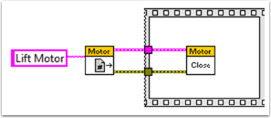
Other motors – close
Finally, we need to close the references in the Finish.vi (just like we do with the drive and joystick), using the Motor Control Refnum Registry Get VI and Motor Control Close VI. While this picture shows the Close VI in a flat sequence structure by itself, we really want all of the Close VIs in the same frame. You can just put these two VIs below the other Get VIs and Close VIs (for the joystick and drive).

Slide 30
Joysticks
Initialize
Close
Assign controls
Retrieve values

Slide 31
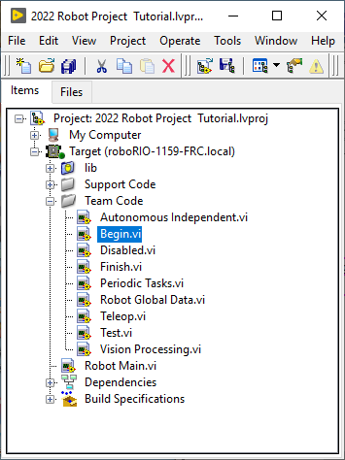
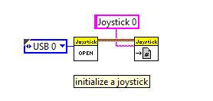
Joysticks - initialize
The following code goes in Begin.vi

Slide 32
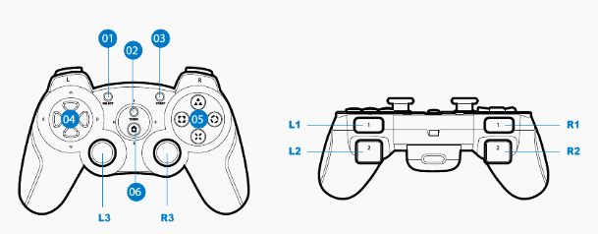
Joysticks – Assign buttons

Slide 33
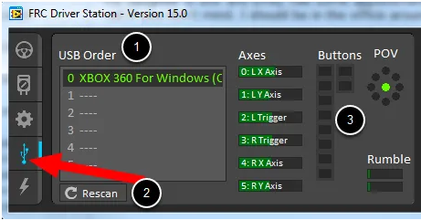
Joysticks – Driver station

Slide 34
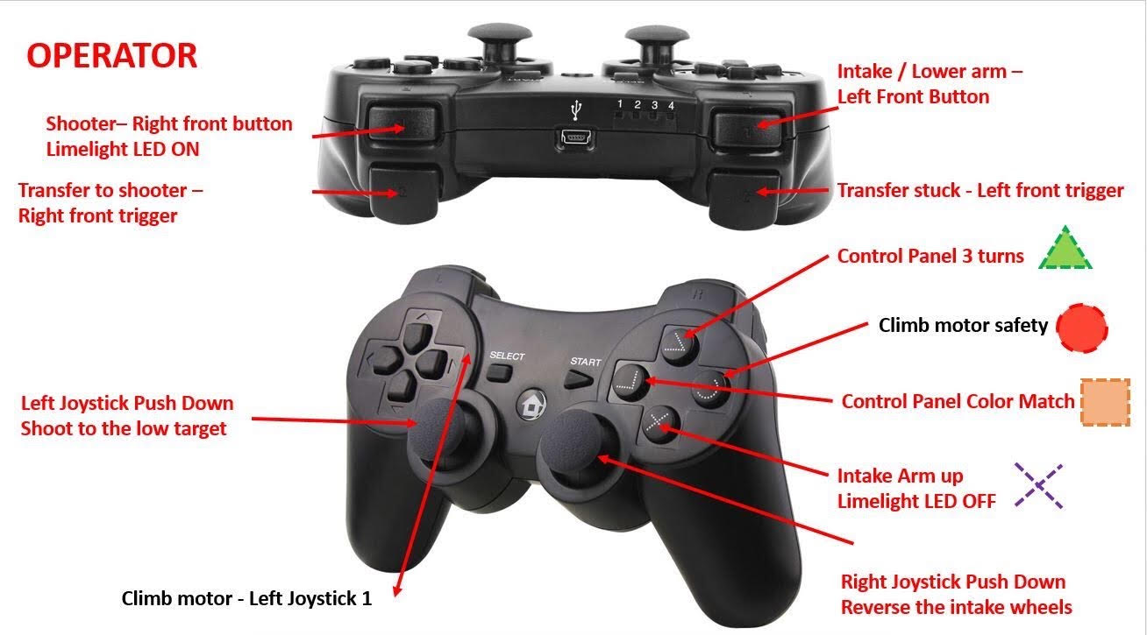
Joysticks – Assign buttons

Slide 35
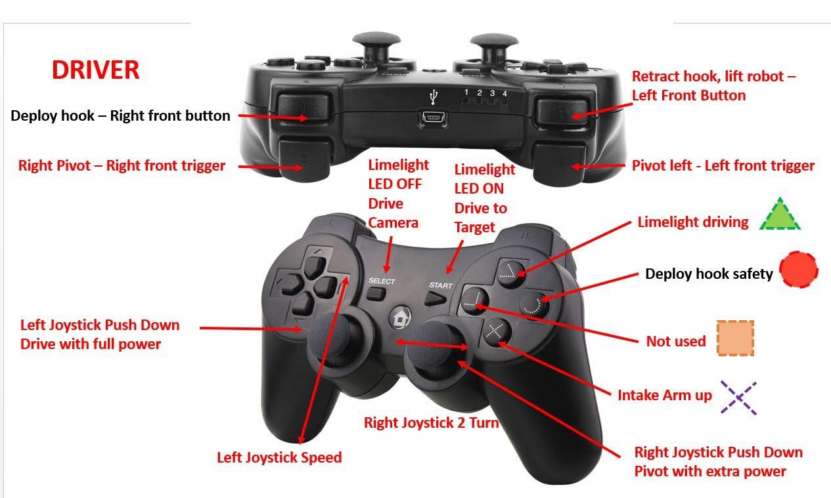
Joysticks – Assign buttons

Slide 36

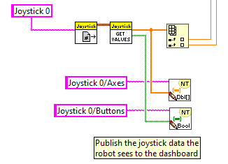
Joysticks – Read joystick values
The following code goes in Teleop.vi

Slide 37
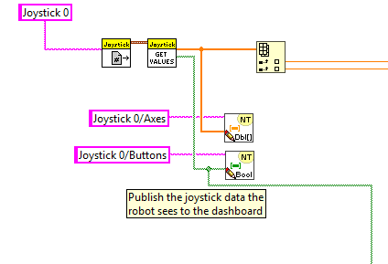
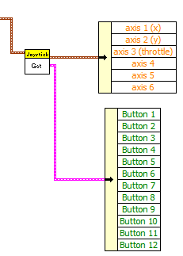
Joysticks

Slide 38
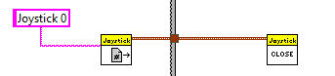
Joysticks – close joystick
The following code goes in Finish.vi

Slide 39
Camera
Program

Slide 40
sensors
Program

Slide 41
Setting up the robot radio
Note At official FRC events, you must use the FRC Radio Kiosk at the inspection table to configure your radio.

Slide 42
Setting up the robot radio
Programming your Radio
What is the Radio?
Download Radio programming tool (installer)
Diagram
Program Radio

Slide 43
Download the robot radio tool
Download Radio programming tool (installer)
FRC Radio Configuration 20.0.0

Slide 44
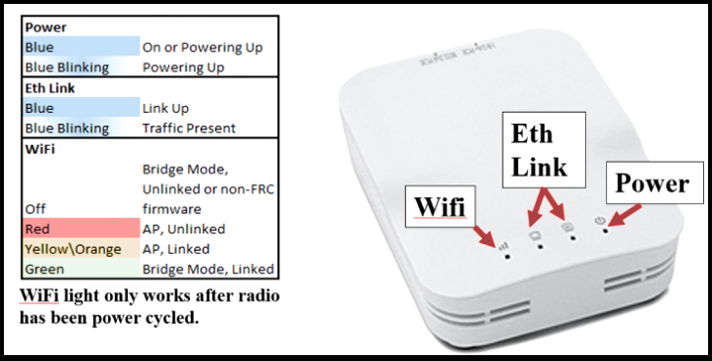
robot radio description

Slide 45
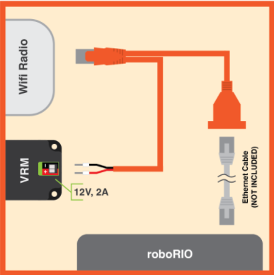
Wiring the robot radio

Slide 46
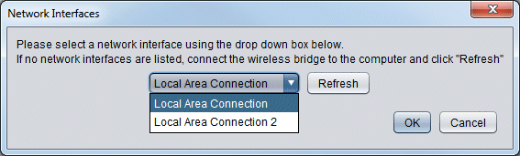
Setting up the robot radio
Configuring the Radio for Competitions
Complete the following steps to configure a radio for development.
Launch the Radio Configuration Utility that you installed from this link
In the Network Interfaces dialog of the utility, select the network interface (the Ethernet port) your radio is connected to and press OK.
 | Note If the roboRIO Imaging Tool fails to update the roboRIO, turn off Windows Firewall in the Control Panel of Windows.

Slide 47
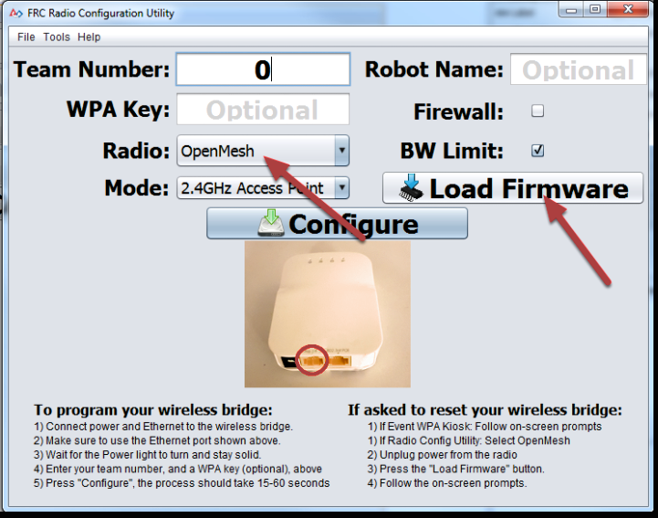
Setting up the robot radio
In the utility, enter your team number, choose your radio type, and follow the directions
 | Note If the roboRIO Imaging Tool fails to update the roboRIO, turn off Windows Firewall in the Control Panel of Windows.
When you press Configure, you should see a Configuration Progress dialog followed by a Complete dialog.

Slide 48
Imaging the roborio

Slide 49
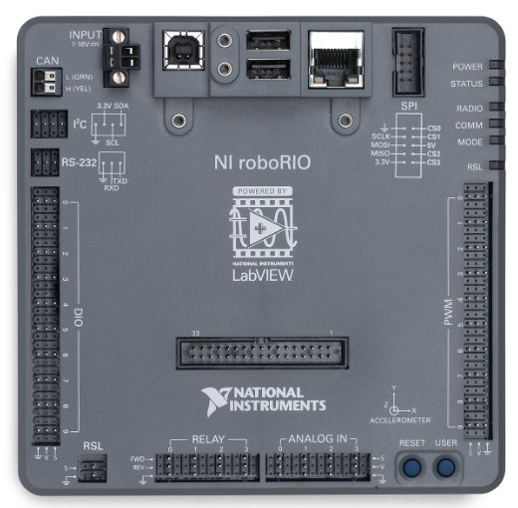

Slide 50
Imaging the roborio
Imaging your roboRIO
Instructions
Check RoboRIO firmware

Slide 51
Imaging the roborio
Setting up the roboRIO
You must configure the roboRIO and the Axis camera (if using one) before you can run a robotics program on the robot.
To configure the roboRIO, you must A) connect the computer to the roboRIO, and then B) run the roboRIO Imaging Tool.
A) Connecting the Computer to the roboRIO
Use a USB cable to connect the computer (USB A-Type) to the USB Device Port (USB B-Type) of the roboRIO (the single USB port next to the INPUT power). Then configure the roboRIO with the roboRIO Imaging Tool.
B) Running the roboRIO Imaging Tool
Considerations Before Running the roboRIO Imaging Tool
Do not use the roboRIO Imaging Tool on the roboRIO over a wireless connection. If the connection is lost, the data that the roboRIO Imaging Tool writes to the roboRIO is corrupted.
Do not use the roboRIO Imaging Tool on the roboRIO over Ethernet. While this should work, it is not as reliable as USB.
Do not use Measurement & Automation Explorer (MAX) to install additional software on the roboRIO. MAX overwrites the FRC VIs on the roboRIO. If you use MAX to install additional software on the roboRIO, you must use the roboRIO Imaging Tool to restore the device to a usable state.
 | Note If the roboRIO Imaging Tool fails to update the roboRIO, turn off Windows Firewall in the Control Panel of Windows.

Slide 52
Imaging the roborio
Running the roboRIO Imaging Tool
Complete the following steps to configure the roboRIO with the roboRIO Imaging Tool.
Select roboRIO Imaging Tool 2020 from the Utilities tab of the LabVIEW Getting Started Window, or by selecting Tools»roboRIO Imaging Tool... from within LabVIEW, or by double-clicking the roboRIO Imaging Tool shortcut on the Windows Desktop.
Select the roboRIO you want to configure from the roboRIO Targets table. This table lists all roboRIOs connected to the host computer.
Choose the task for the imaging tool to perform:
Edit Startup Settings allows you to change startup settings and your team number.
Format Target is used to image the roboRIO and set your team number. From the Select Image list, select the most recent .zip file to download the most recent image to the roboRIO. If you do not see a .zip file, you must install the FRC Game Tools. Enter your team number in the Team Number text box, and click the Reformat button to download the image to the roboRIO. Do not turn off power to the roboRIO or interfere with the USB connection while the roboRIO Imaging Tool downloads the image to the roboRIO.
Update Firmware is used to download the latest firmware to the roboRIO. The minimum required firmware for FRC 2020 is version 5.0.0. The latest firmware version is 6.0.0, and is included with this update. To update, choose the latest .cfg file from the Select Firmware list and click the Update button. Do not turn off power to the roboRIO or interfere with the USB connection while the roboRIO Imaging Tool updates the roboRIO firmware.
 | Note If the roboRIO Imaging Tool fails to update the roboRIO, turn off Windows Firewall in the Control Panel of Windows.

Slide 53
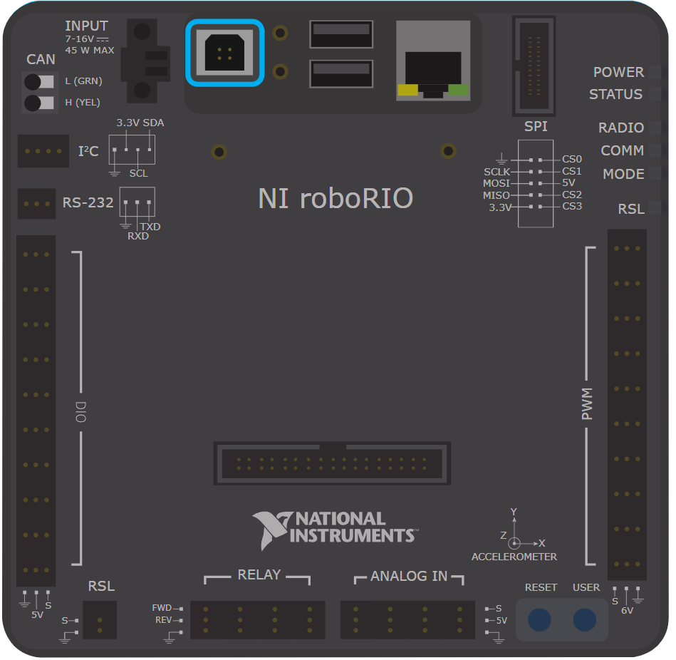

Slide 54
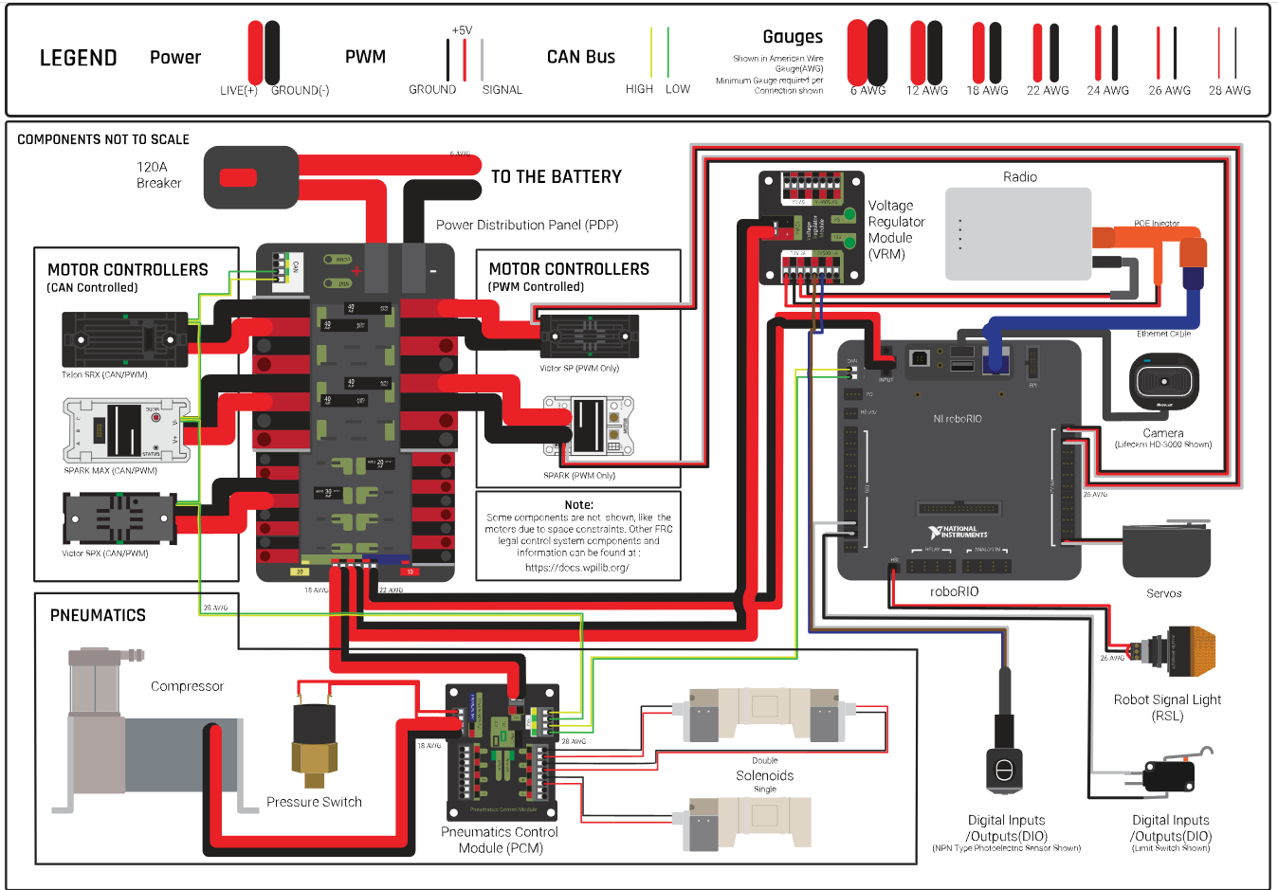

Slide 55
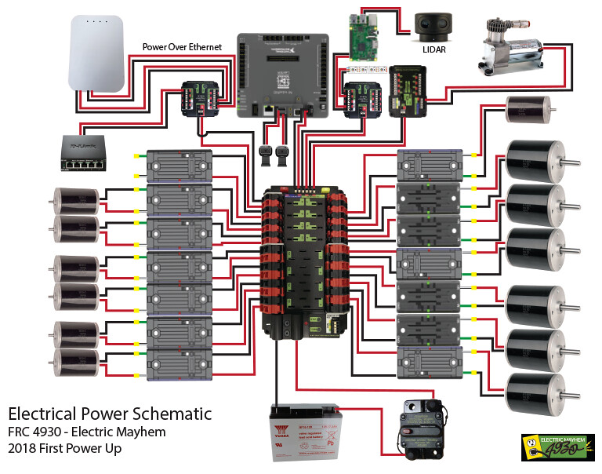

Slide 56
Program the motor controllers

Slide 57
template
template

Slide 58
Make a robot program build

Slide 59
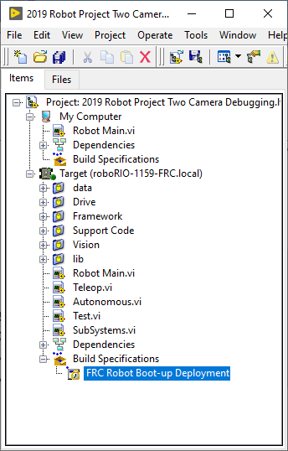
template
template

Slide 60
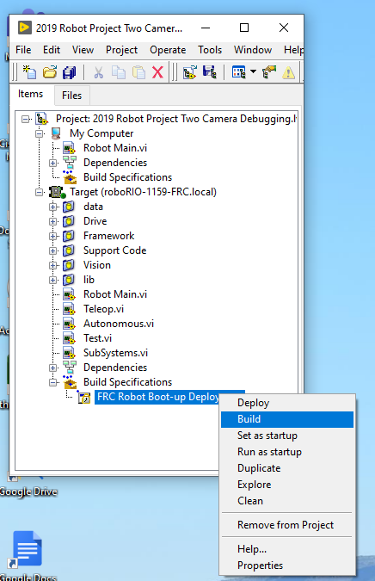
template
template

Slide 61
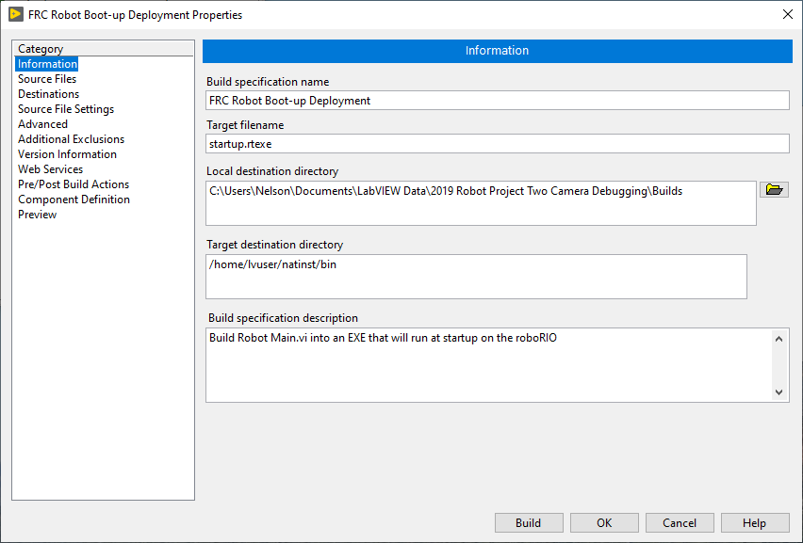
template
template

Slide 62
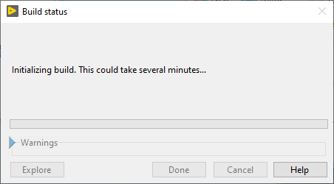
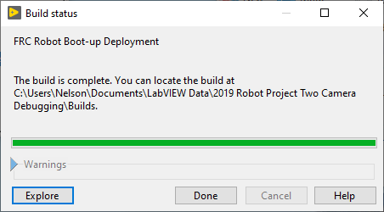
template
template

Slide 63
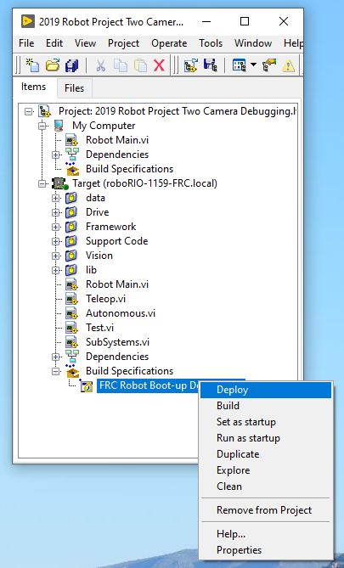
template
template

Slide 64
template
template

Slide 65
template
template

Slide 66
Deploy the robot program build

Slide 67
template
template

Slide 68
Learn to use github

Slide 69
Github
Get a Github account
Learn to how use it
Link to team’s Github
Checkout code
Check in code

Slide 70
Template section divider

Slide 71
Team’s progress

Slide 72
Software team’s progress

Slide 73
resources
http://www.ni.com/first
https://www.firstinspires.org/resource-library/frc
http://www.chiefdelphi.com
Technical>Programming>LabVIEW

Slide 74
LABVIEW tutorials
Getting Started with LabVIEW
FRC LabVIEW Tutorial
Fundamentals of LabVIEW for FRC - Episode 1
Fundamentals of LabVIEW for FRC: Episode 2 - Vision and Control
Fundamentals of LabVIEW for FRC: Episode 3 - Command and Control Architecture

Slide 75


Slide 76


